Slide 1

C379 Emerging technologies
Lesson 16: Data Preparation

Slide 2

L16 Learning Objectives
Explain the use of predictive analytics to predict trends by solving classification problems using data
Explain and differentiate between train, validation, and test datasets for predictive analytics
Prepare train, validation and test datasets for predictive analytics from data for a given scenario
List and describe three (3) different machine learning algorithms used to perform classification tasks in AI
Apply these three (3) machine learning algorithms to train predictive models
Test and evaluate the three (3) predictive models and identify the one that will produce the best solution for the given scenario
Explain and effectively present results to end-user devices

Slide 3


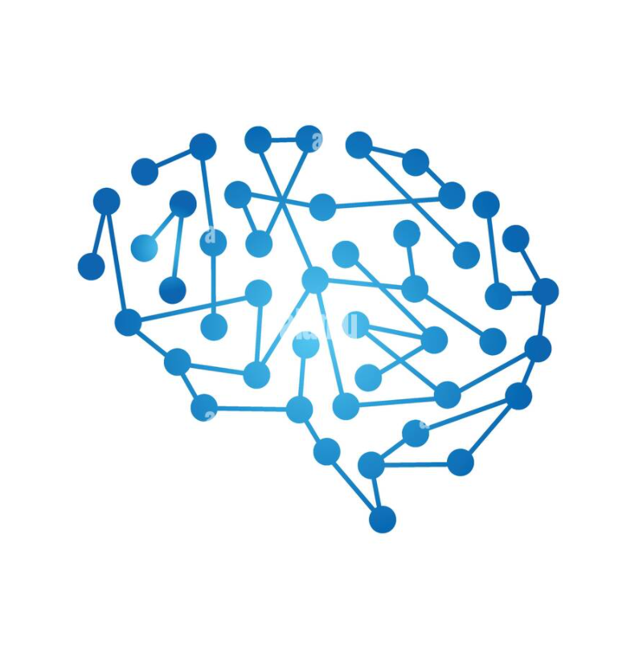
Predictive Analytics

Slide 4
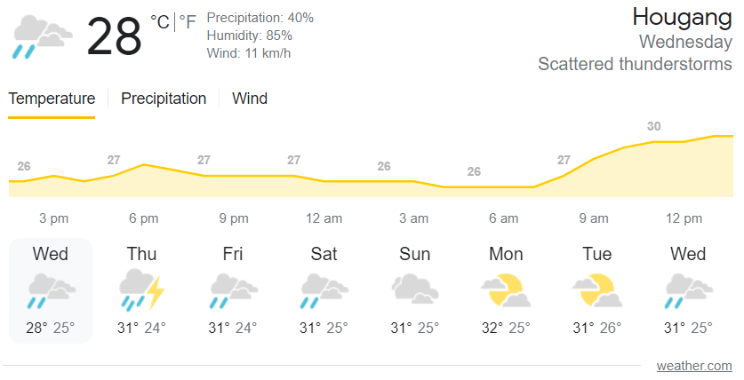
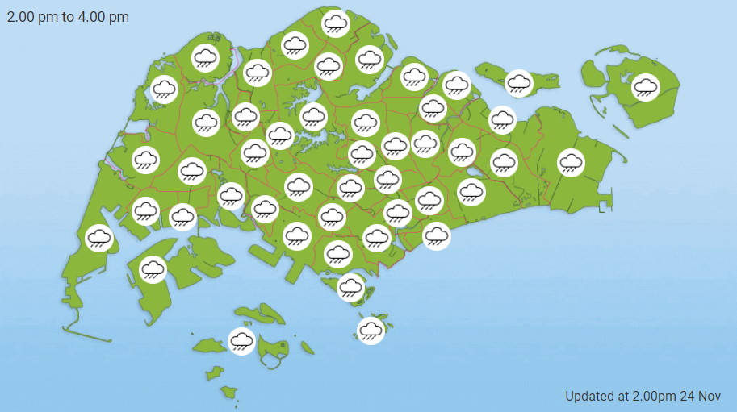
Weather Prediction
Take a moment to discuss some of these questions?
Where do you get your weather forecast?
How does the app predict tomorrow’s weather?
What will be the prediction of the weather on this year’s National Day?
Why the forecast is inaccurate most of the time?

Slide 5
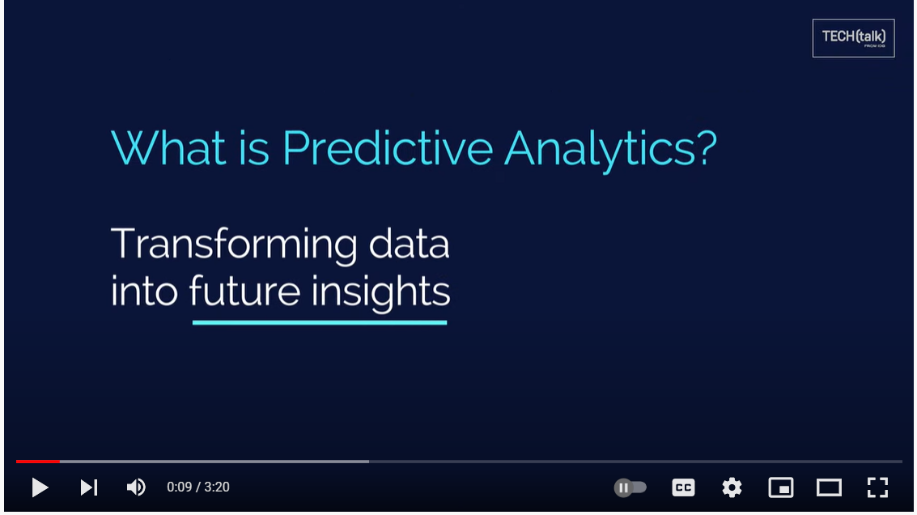
Predictive Analytics
https://www.youtube.com/watch?v=cVibCHRSxB0

Slide 6
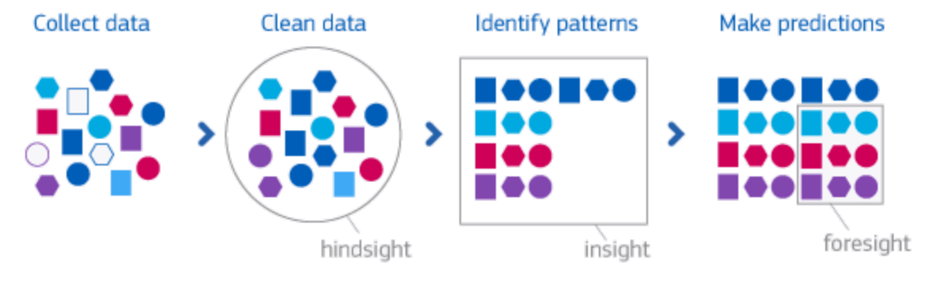
Predictive Analytics
Predictive analytics is the use of data, statistical algorithms and machine learning techniques to identify the likelihood of future outcomes based on historical data.
The goal is to go beyond knowing what has happened to providing a best assessment of what will happen in the future.
In this lesson, we will build AI models that predict categories. This class of machine learning problems is known as classification tasks.

Slide 7
Classification Tasks
Classification tasks belongs to the supervised learning branch of ML. These kinds of tasks are the most widely used in applications in industry.
ML classification models can output 2 types of predictions:
Predicted classes: For every observation, the model will directly give the prediction of the class.
Probabilities of each class: For every observation and every class, the model will output probabilities of that observation belonging to the class.

Slide 8
Predicting Categories using classification Models
We want to use the variables (Chest Pain, Good Blood Circulation, etc) to predict if someone has heart disease.
Chest Pain | Good Blood Circ. | Blocked Arteries | Weight | Heart Disease
No | No | No | 45 | No
Yes | Yes | Yes | 80 | Yes
Yes | Yes | No | 90 | No
… | … | … | … | …
When a new patient shows up, we can measure these variables to predict if he/she has heart disease or not.
Chest Pain | Good Blood Circ. | Blocked Arteries | Weight | Heart Disease
Yes | No | No | 56 | ???

Slide 9
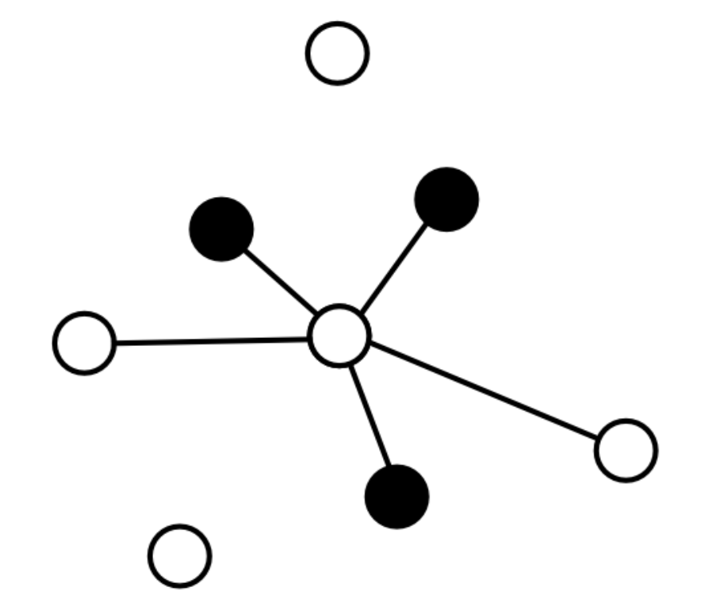
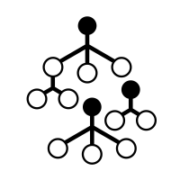
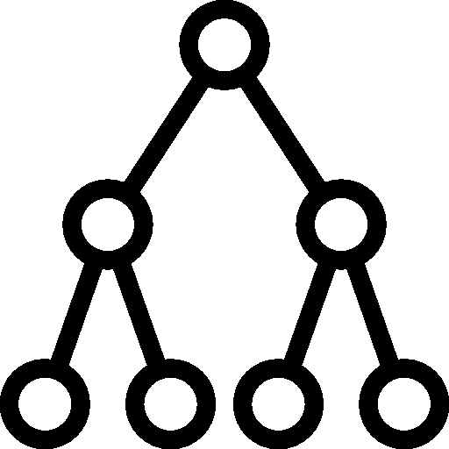
Predicting Categories using classification Models
However, first we have to decide which machine learning method would be best …
And many more machine learning methods…
K-nearest neighbours…
or Decision Tree…
or Random Forest?

Slide 10
Predicting Categories using classification Models
From the data that we have collected about people with and without heart disease.
From this data, we need to estimate the parameters for the machine learning methods.
In other words, to use K-nearest Neighbours (KNN) method, we have to use some of the data to estimate the distance between each point.
In machine learning lingo, estimating parameters is called “training the algorithm”.

Slide 11
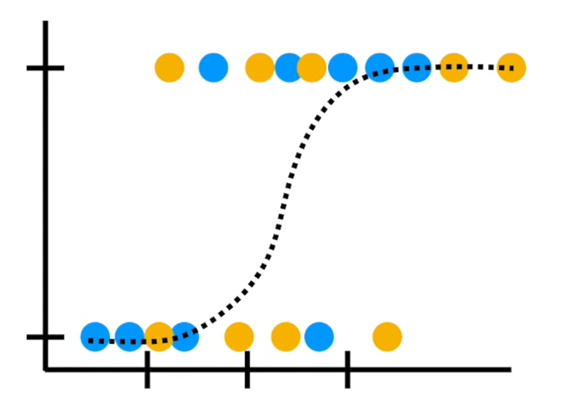
Data Preparation
Using machine learning, we need the data to….
Train the machine learning methods
Test the machine learning methods.
A terrible approach would be to use all of the data to estimate the parameters (i.e. train the algorithm), because then there would not be any data left to test the method.
Reusing the same data for both training and testing is a bad idea because we need to know how the method will work on data it was not trained on. Otherwise, it will lead to a problem known as overfitting.

Slide 12
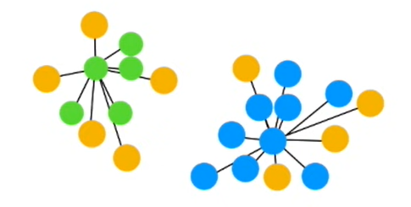
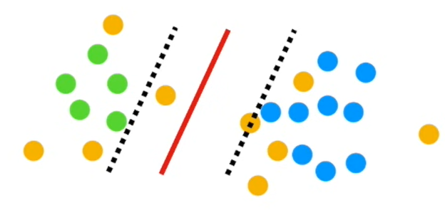
Data Preparation
A better approach would be to use the first 70%-80% of the data for training,
and the last 20%-30% of the data for testing.
We could then compare methods by seeing how well one categorised the test data.
Training Dataset
Testing Dataset

Slide 13
Difference between training, Validation & test Data
Training data
Large portion of the dataset in a corpus should be reserved for training your predictive models
By default, 60% of your dataset is recommended to be set aside as the training set
Validation data
The validation set is a separate section of your dataset that you will use during training
The purpose of validation data is to get a sense of how well your model is doing on data that are not being used in training
20% of your dataset is recommended to set aside as the validation set
Test data
To prevent overfitting the new model, evaluation metrics can be run on the test set at the end to get a sense of how well your predictive models will perform in production
20% of your dataset is recommended to set aside as test set

Slide 14
Common Pitfalls in the Train, Validate & Test Split
Train/Test Bleed
This is when some of your testing data are overly similar to your training data
When duplicating data in the dataset, ensure that these data do not enter different train, validation and test splits
Overemphasis on the Training Set
The more data, the better the model. However, this mantra might tempt you to use most of your dataset for the training set and only to hold out 10% or less for validation and test.
Skimping on your validation and test sets could cloud your evaluation metrics with a limited subsample, and lead you to select a suboptimal model
Overemphasis on Validation and Test Set Metrics
Validation and test set metrics are only as good as the data underlying them
They may not be fully representative of how well you model will perform in production

Slide 15
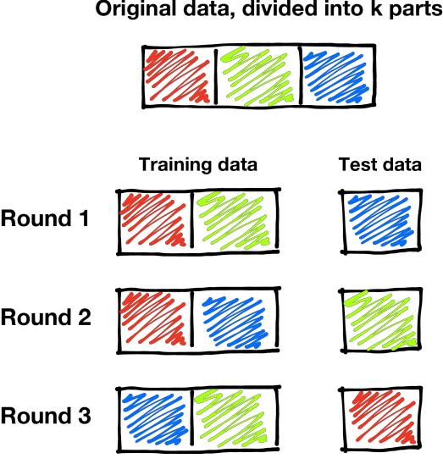
Challenge of using Validation Data
One unfortunate effect of validation set is that we can now use only 60% of the original data to train the predictive models.
This can be an issue if we have a very limited amount of training data to begin with.
Nevertheless, this problem can be addressed by using a technique known as cross-validation.
Cross-validation avoids holding out parts of the dataset to be used as validation data, but at the expense of additional computation.

Slide 16
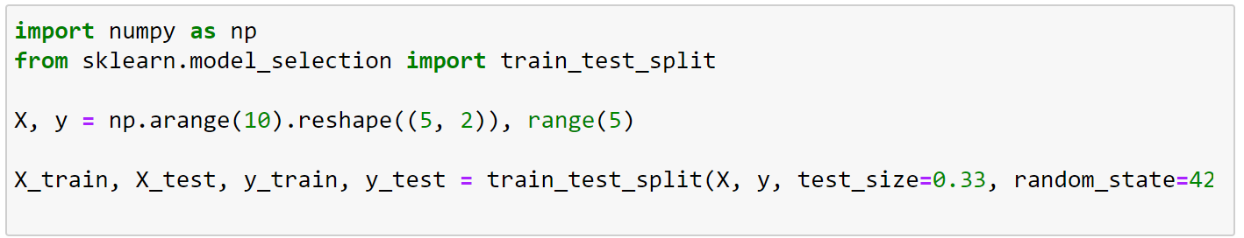
Prepare training and testing data
1. Importing train_test_split method from scikit-learn’s model_selection library
2. Example of creating a 5x2 matrix for dataset X and a vector y (label or outcome) with sequential numbers
4. The parameters used for the method can be included:
test_size – proportion of dataset allocating for testing
random_state – seed number used to shuffle the data
3. This method split the dataset into 4 different segments:
X_train – Data use for training the predictive model
X_test – Data use for testing the model
y_train – Labels corresponding to X_train
y_test – Labels corresponding to X_test

Slide 17
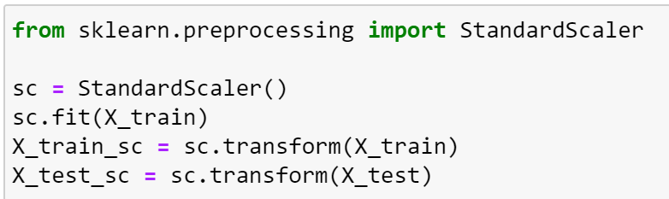
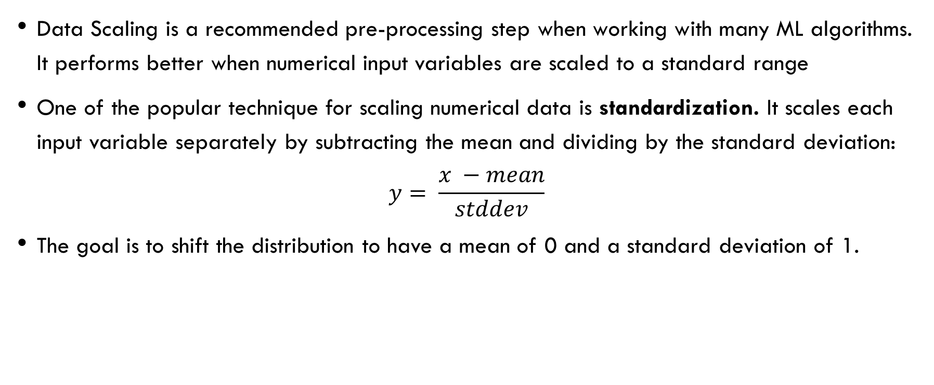
Applying Data Scaling
Data Scaling is a recommended pre-processing step when working with many ML algorithms. It performs better when numerical input variables are scaled to a standard range
One of the popular technique for scaling numerical data is standardization. It scales each input variable separately by subtracting the mean and dividing by the standard deviation:
$$y= \frac{x −mean}{stddev}$$
The goal is to shift the distribution to have a mean of 0 and a standard deviation of 1.
1. Importing StandardScaler method from scikit-learn’s preprocessing library
2. Apply standard scaling to the train & test dataset

Slide 18

Practical
Lab 16-1
Data Preparation

Slide 19
Unscheduled Asynchronous e-learning
Watch the following videos before Lessons17 :
KNN – https://www.youtube.com/watch?v=HVXime0nQeI
60 mins

